Slide 1


PRODUCT WALKTHROUGH
NIS2 Manager
Implement, document and evidence NIS 2 — in a single application
TSMONDO · Münster
Notes:
The NIS 2 Directive requires many medium-sized companies to put measures, evidence and reporting channels in place. The NIS2 Manager from TSMONDO takes you through those obligations, locally on your own machine, in a single application.

Slide 2


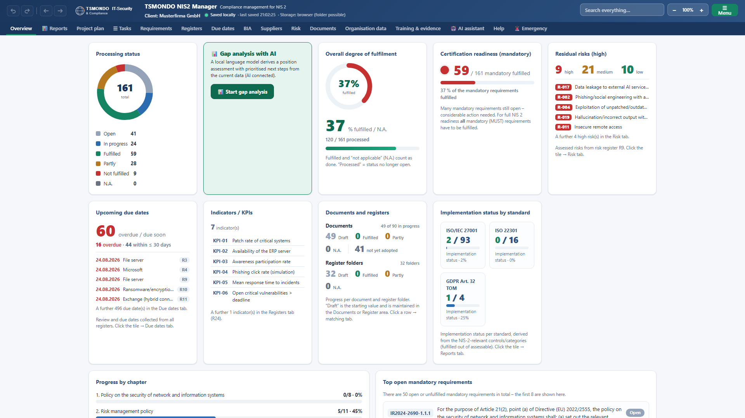
INTRODUCTION
What the
application does
Runs locally on your machine
161 requirements, 32 registers
Over 80 document templates
tsmondo.eu · Münster
01 / 20
Notes:
The NIS2 Manager is an application for implementing and evidencing the NIS 2 obligations. The application itself runs locally on your own machine, with no server and no customer account. It ships with 161 requirements, 32 registers and over 80 document templates. What you see here is the overview: the current state of implementation, available at any time.

Slide 3
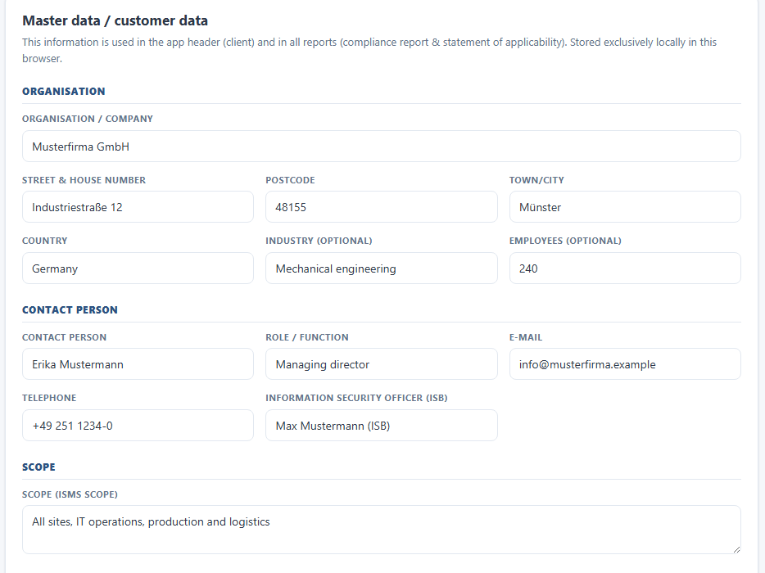
ORGANISATION DATA
Enter once, used
everywhere
Organisation and scope
Feeds reports and templates
Your own logo
tsmondo.eu · Münster
02 / 20
Notes:
Everything starts with the organisation data. Organisation, responsible persons, scope and contact details are entered once. These entries appear in the header of the application, in every report and in every document template, whose placeholders are filled from them automatically. You can store your own logo. Whether your company counts as an essential or an important entity is settled by the guided project plan in its very first step.

Slide 4
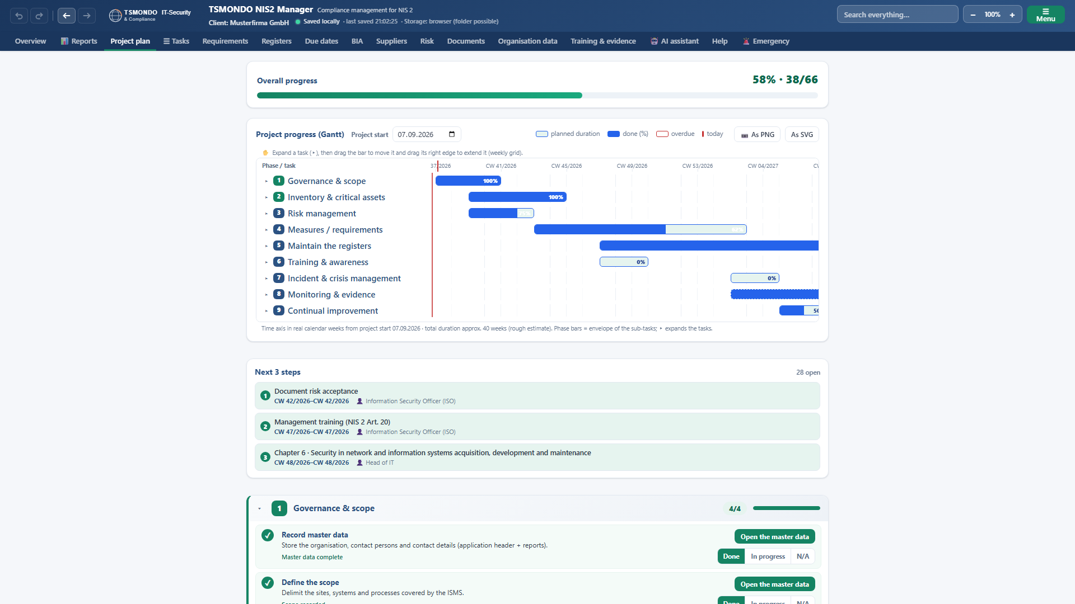
PROJECT PLAN
The guided
route
9 phases from start to evidence
Every step jumps to its place
Status is reported back
tsmondo.eu · Münster
03 / 20
Notes:
Anyone unsure where to begin follows the project plan. In 9 phases it leads from governance and scope through inventory, risk management and measures to evidence and continual improvement. Every step jumps precisely to where the work is done, and reports its status back to the plan.

Slide 5
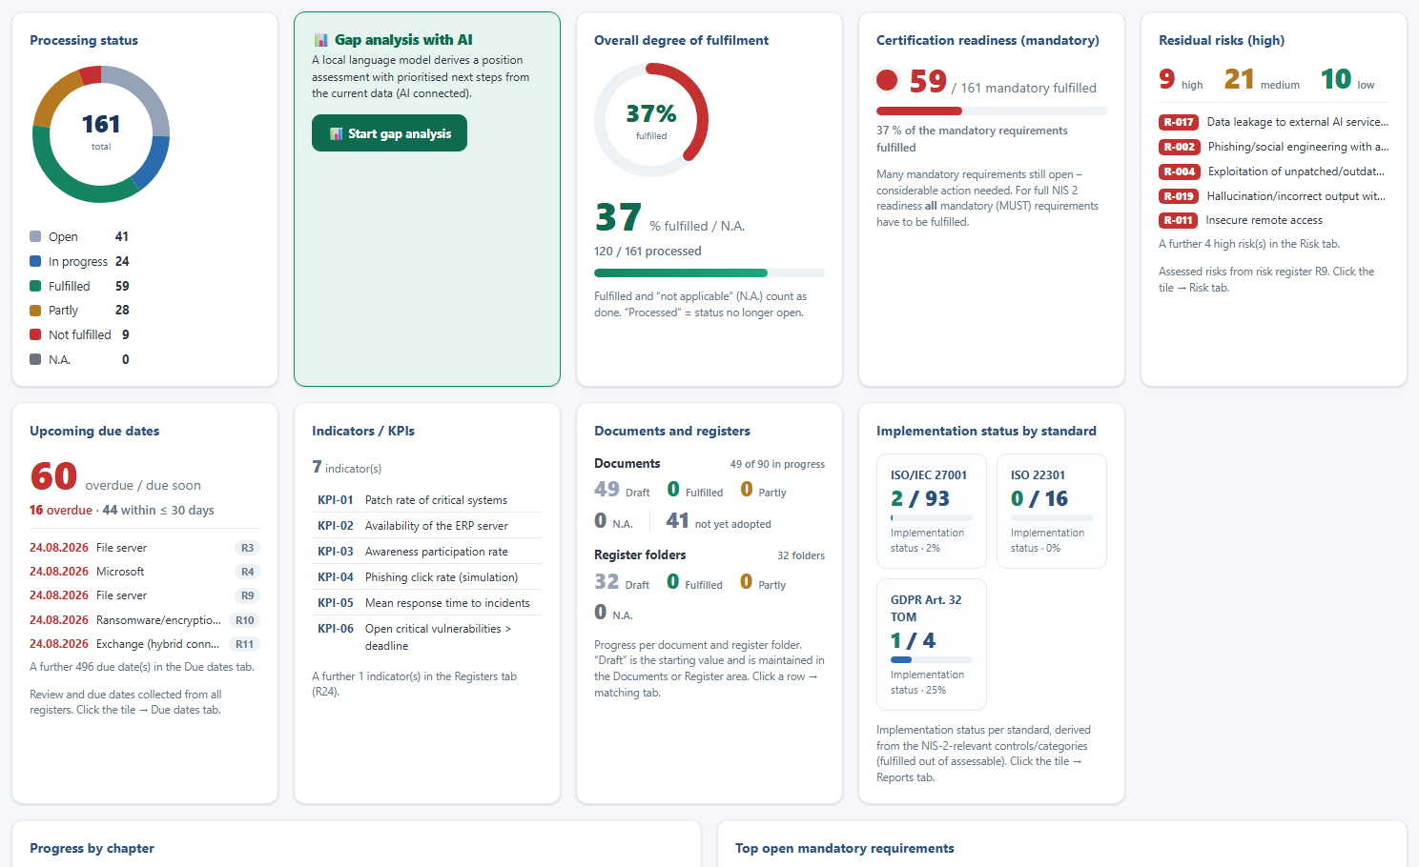
OVERVIEW
The current
position at a glance
Level of fulfilment and readiness
Residual risks and due dates
Status per standard
tsmondo.eu · Münster
04 / 20
Notes:
The overview condenses the current position: level of fulfilment, processing status and a traffic light for certification readiness. Next to them are the open residual risks from the risk register, the upcoming due dates and your own metrics. Below that, tiles show the implementation status per standard, among them ISO 27001, ISO 22301, and Article 32 of the General Data Protection Regulation.

Slide 6
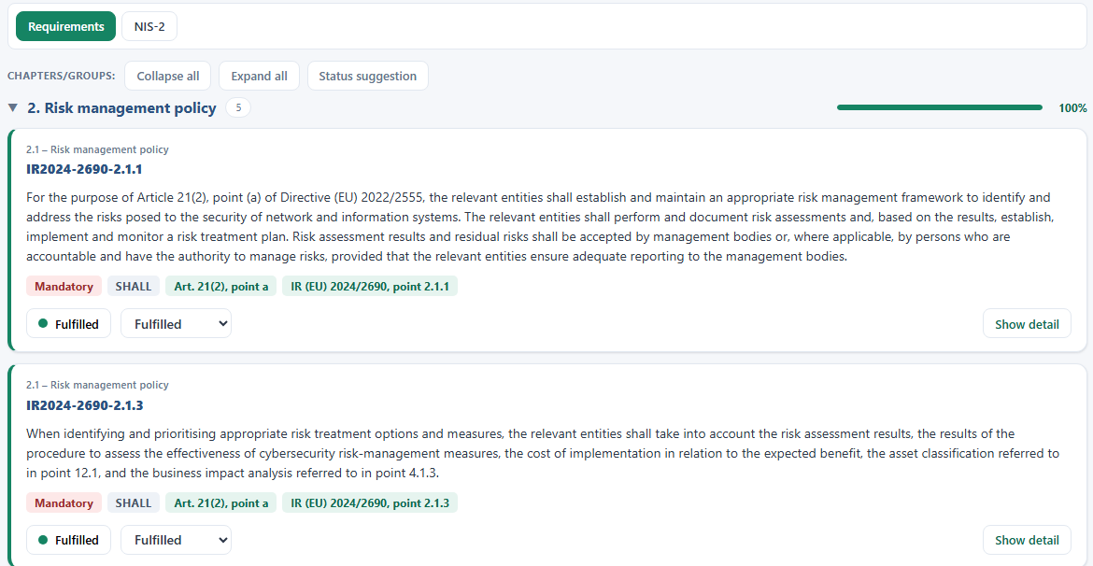
REQUIREMENTS
Assess and
evidence
161 requirements
Status, comment, evidence
Reference to Article 21
tsmondo.eu · Münster
05 / 20
Notes:
The catalogue holds 161 requirements set out in Commission Implementing Regulation 2024/2690, each carrying its reference to Article 21. For each of them you set a status, enter a comment and record the evidence. For every requirement the application suggests matching evidence and documents, which can be opened directly. A switch lets you view the same position against a different standard profile.

Slide 7
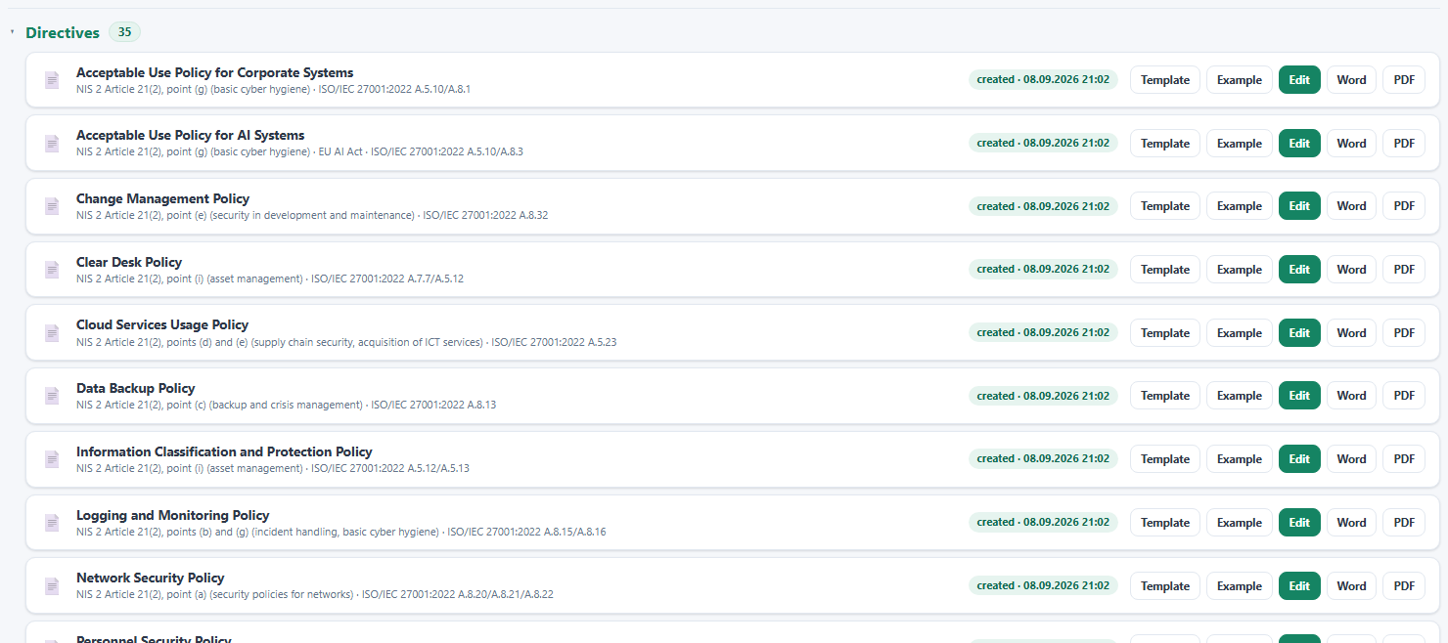
DOCUMENTS
Templates with a
worked example
Over 80 templates, sorted
Each template names its
requirement
A completed example included
tsmondo.eu · Münster
06 / 20
Notes:
The documents area holds over 80 templates: policies, directives, fact sheets, checklists, concepts, procedures and playbooks, sorted into categories. Every template comes with a fully completed example that shows what the finished document looks like. Each template names the requirement it satisfies.

Slide 8
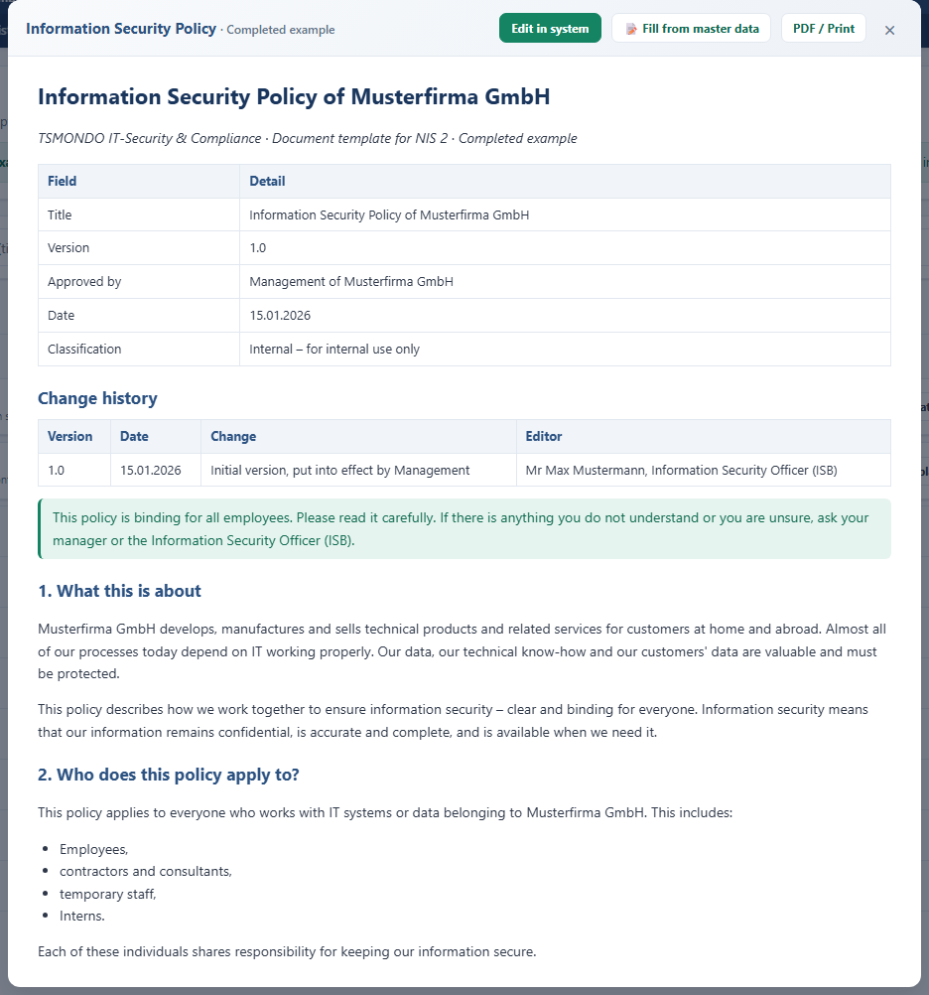
EDITOR
From template to
your document
Template and worked example
Editor built into the program
Export as Word or PDF
tsmondo.eu · Münster
07 / 20
Notes:
Every template comes in two forms: the blank template and a fully worked example. You adopt a template into your system, edit the working copy in the built-in editor and output it as a Word file or as a PDF. If you prefer, you can adopt all documents in a single pass.

Slide 9
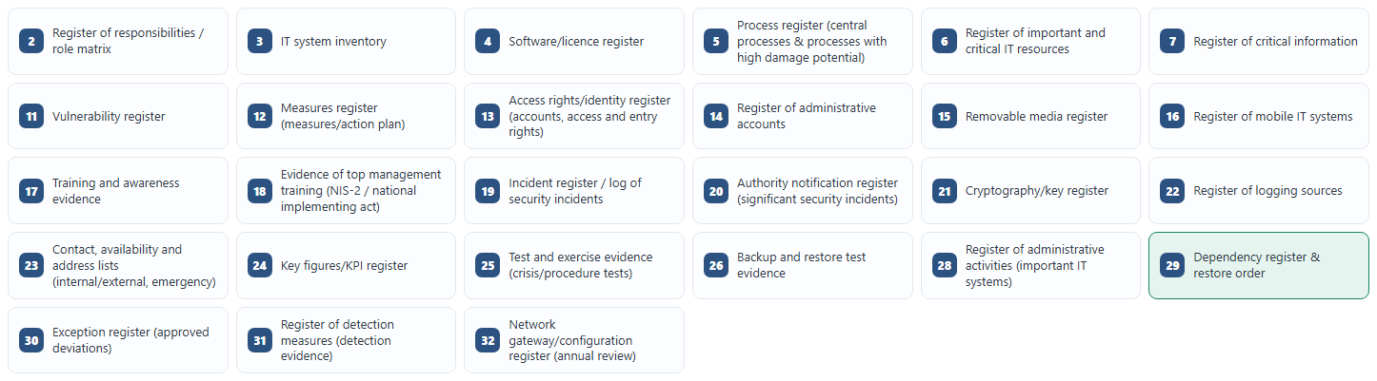
REGISTERS
The evidence
base
32 registers, editable in place
Inventory, processes, incidents
Import and export as CSV
tsmondo.eu · Münster
08 / 20
Notes:
32 registers make up the evidence base. 27 of them sit in the registers area: role matrix, inventory of systems and software, processes, critical information, incidents, training and key figures. Risks and suppliers each have an area of their own, because more than one table belongs to them. Every table can be edited directly in the view and can be exported as a CSV file and imported again. Example rows show what belongs in each column.

Slide 10
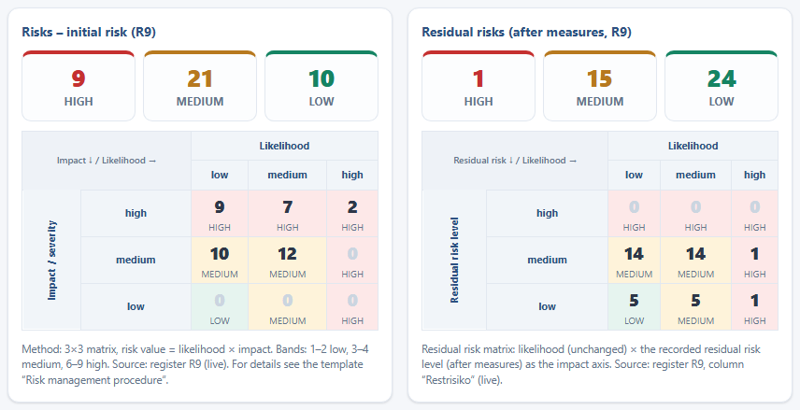
RISK
Assess and
treat
Risk register and matrix
Likelihood times impact
Measures with owners
tsmondo.eu · Münster
09 / 20
Notes:
The risk register and the treatment plan sit together in the risk area. You assess each risk by likelihood and impact on three levels, and the matrix shows the distribution. For every risk you plan measures with owners and dates and link them to the relevant documents and registers. Accepted residual risks are documented.

Slide 11
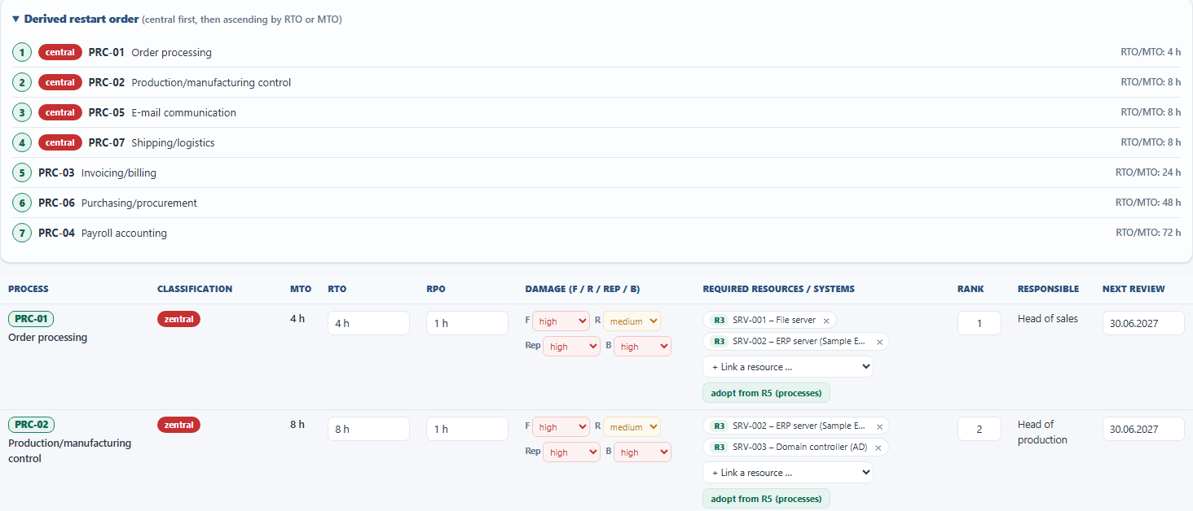
BIA
What has to
run again first
Processes from the register
Outage time and data loss
Recovery sequence
tsmondo.eu · Münster
10 / 20
Notes:
The business impact analysis takes the processes from the process register. The maximum tolerable outage comes from there as well; for each process you add the recovery time objective and the recovery point objective, the data loss that is still acceptable, and you name the resources needed for it. From that the application derives a recovery sequence: central processes first, then by the shortest recovery time.

Slide 12
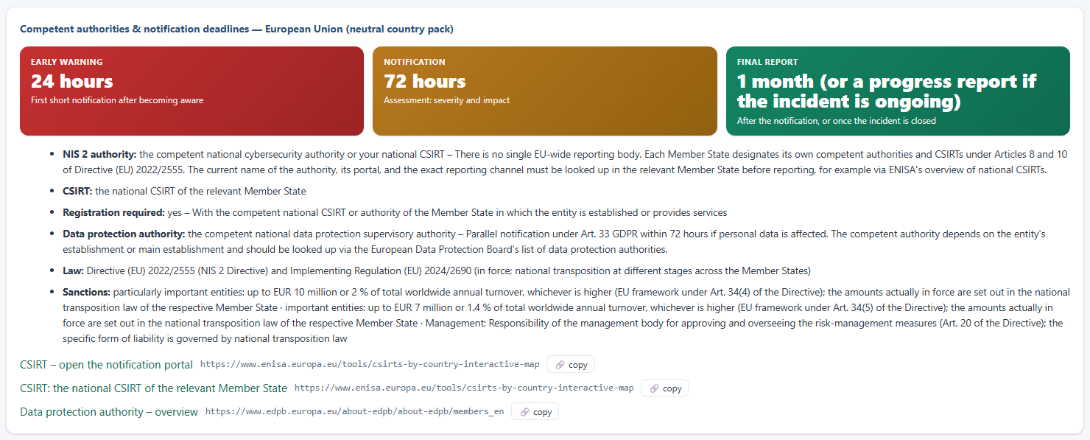
EMERGENCY
Prepared for
the worst case
Immediate actions and contacts
24 hours, 72 hours, one month
Reporting assistant for the
authority
tsmondo.eu · Münster
11 / 20
Notes:
The emergency area is built for the worst case. It shows immediate actions, the recovery sequence, your own emergency contacts and the competent authorities for the selected country. The reporting cascade under the NIS 2 Directive and the applicable national transposition act sits visibly above them: 24 hours for the early warning, 72 hours for the incident notification, one month for the final report. Alongside it, the 72 hour deadline of the data protection supervisory authority. An assistant prepares the notification to the authority, optionally tied to a recorded incident.

Slide 13
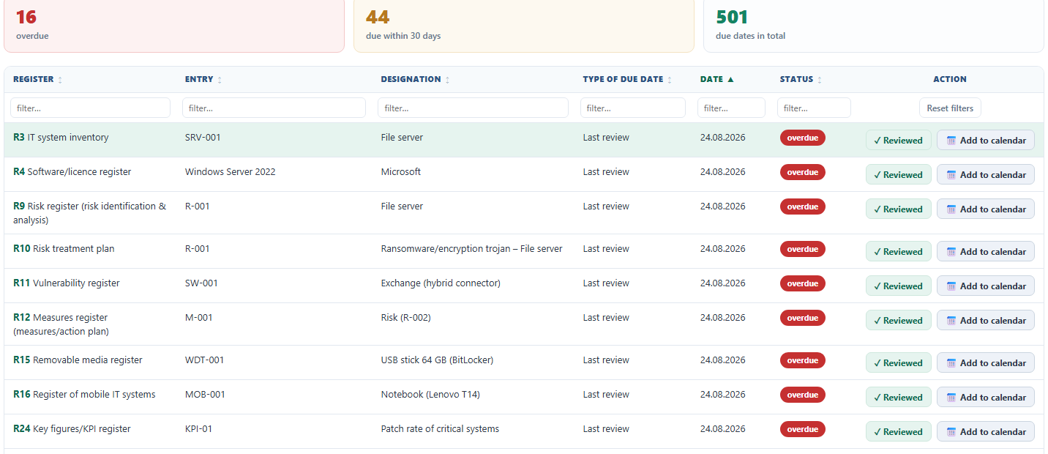
DUE DATES
Dates in view
Dates from every register
Overdue and due within 30 days
Export to the calendar
tsmondo.eu · Münster
12 / 20
Notes:
The application collects due dates from every register automatically: review dates, deadlines, validity periods and recurrence intervals. Overdue dates and everything falling due within the next thirty days stand at the top. One click jumps into the register concerned. All due dates can be written out as a calendar file, with a reminder seven days beforehand.

Slide 14
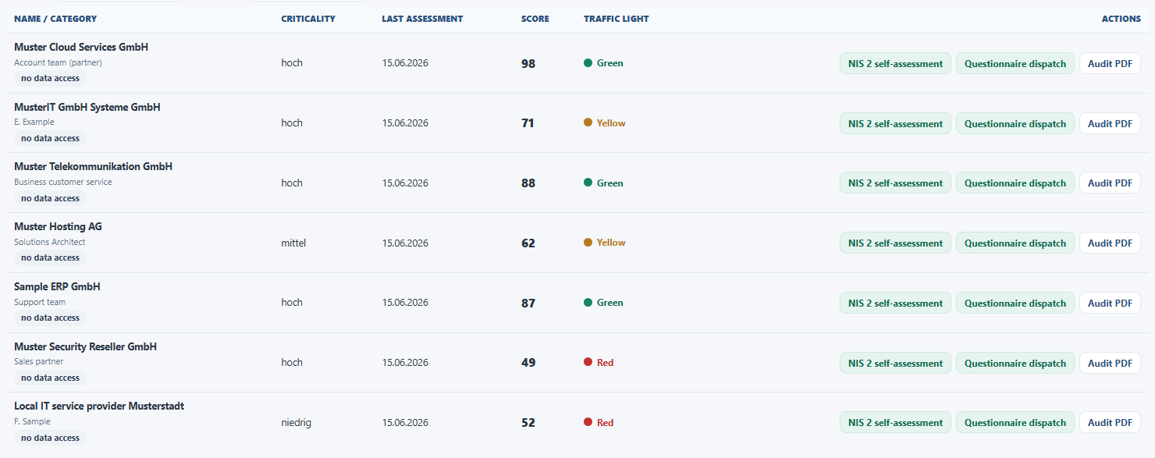
SUPPLIERS
Examining the
supply chain
An obligation in its own right
Weighted questionnaire
A score per supplier
tsmondo.eu · Münster
13 / 20
Notes:
The supply chain is an obligation in its own right under the NIS 2 Directive. In the suppliers area you maintain a list of your service providers and work through a structured questionnaire for each one: management system, risk analysis, access control, business continuity and reporting channels. The questions carry different weights, and from them comes a score that makes visible where a closer look is needed.

Slide 15
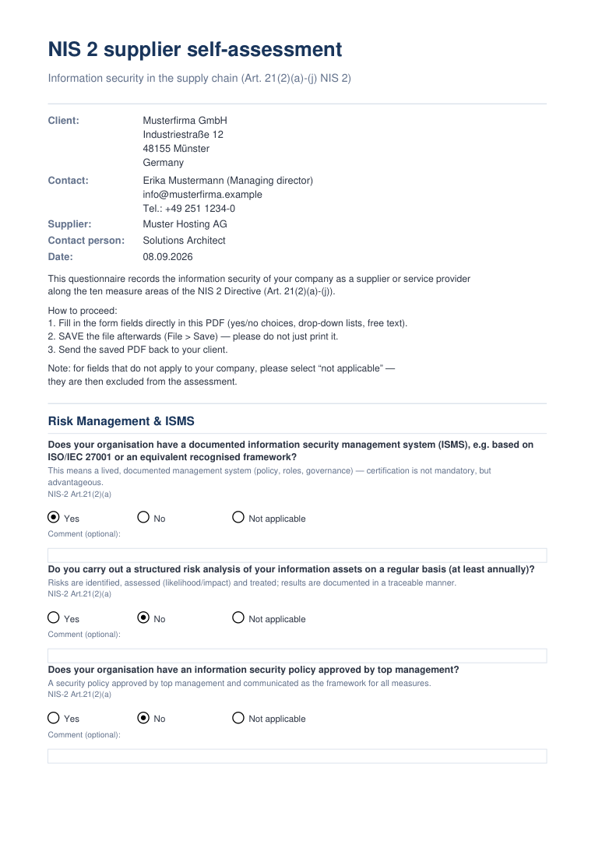
SUPPLIERS
The questionnaire
for the supplier
A fillable PDF
Client and supplier in the header
37 questions, ten areas
tsmondo.eu · Münster
14 / 20
Notes:
Not every supplier will work inside your system. One button therefore produces a fillable PDF: the client, the supplier and the instructions at the top, then 37 questions along the 10 measure areas of Article 21. The supplier ticks yes, no or not applicable, saves the file and sends it back. The document is built inside the programme itself, without a server.

Slide 16
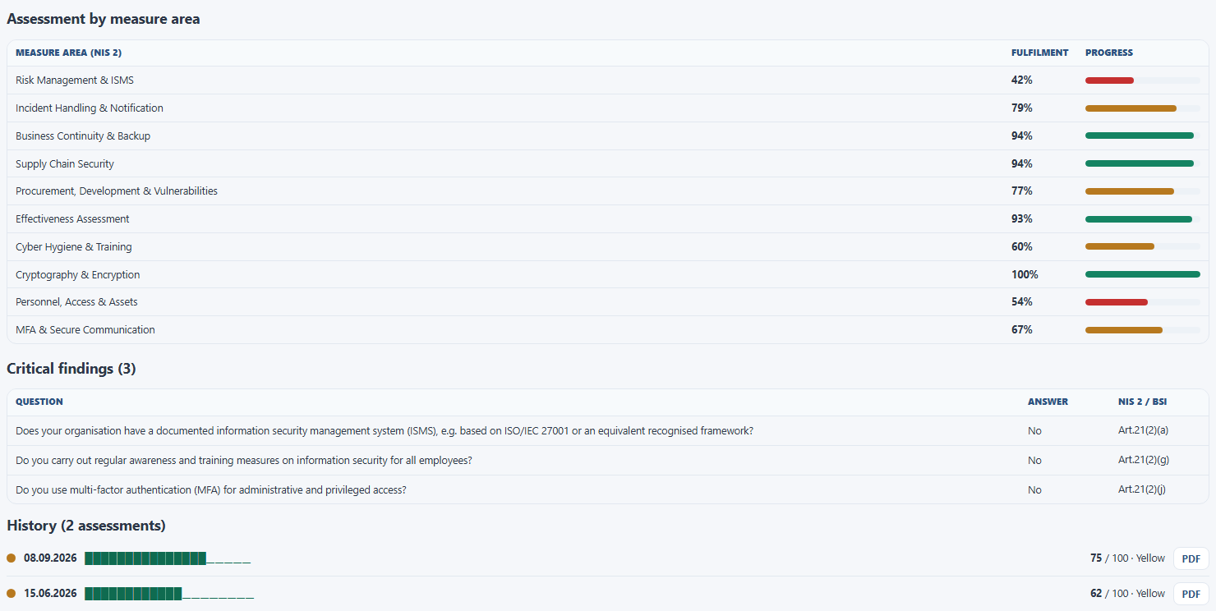
SUPPLIERS
The answer
comes back
Import the answer PDF
Fulfilment per measure area
Score and history
tsmondo.eu · Münster
15 / 20
Notes:
When the completed file comes back, the programme reads it. It identifies the supplier from the identifier inside the document and computes the weighted score. The level of fulfilment appears for each of the 10 measure areas, the critical findings underneath. The history records every assessment with its date: 75 out of 100, traffic light yellow.

Slide 17
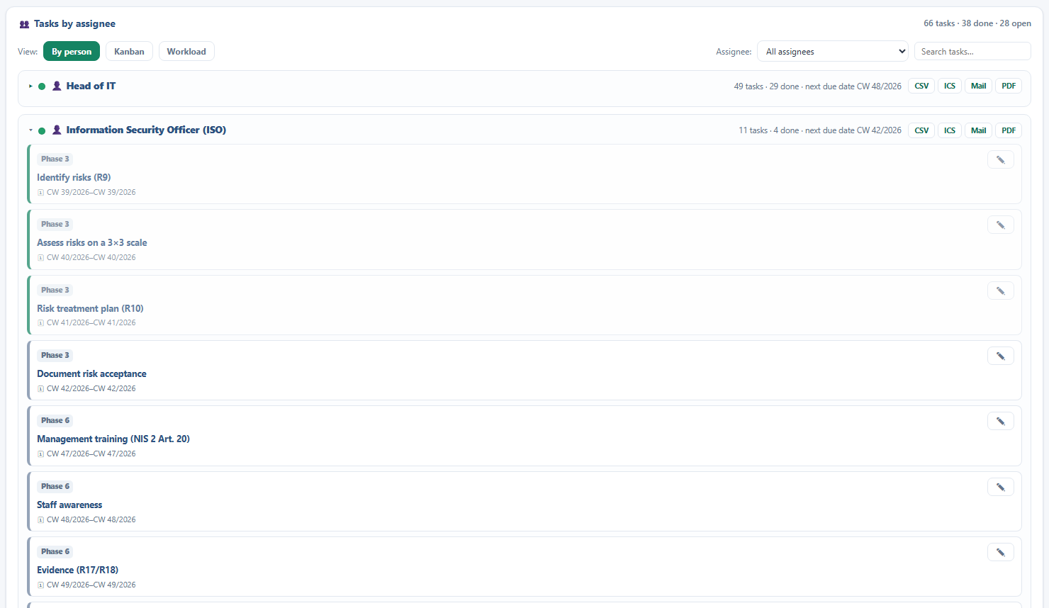
TASKS
Who does
what by when
Tasks from the project plan
Board and bar chart
Output per owner
tsmondo.eu · Münster
16 / 20
Notes:
The project plan produces tasks with a start, an end and an owner. The tasks area shows them as a Kanban board and as a Gantt chart. Overdue tasks are marked, progress is kept as a percentage, and the owners come from your role matrix, that is, from data you maintain anyway. For each owner the list can be output as a calendar file, an email draft or a PDF.

Slide 18
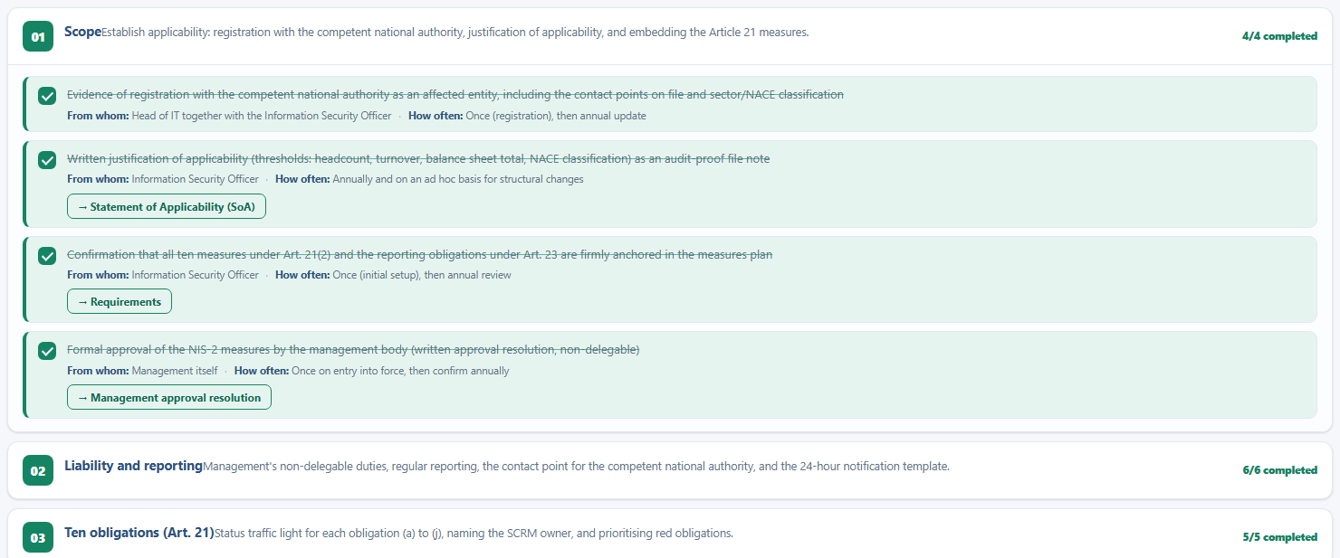
TRAINING
Management
under obligation
A series of 12 modules
Checkpoints for management
Evidence in the registers
tsmondo.eu · Münster
17 / 20
Notes:
Management has to be trained and has to be able to evidence it. The training area holds a complete series of 12 modules, from scope and management duties through risk management to the reporting obligation and the supply chain. Every module comes with checkpoints for the board, and the corresponding evidence flows into the training registers.

Slide 19
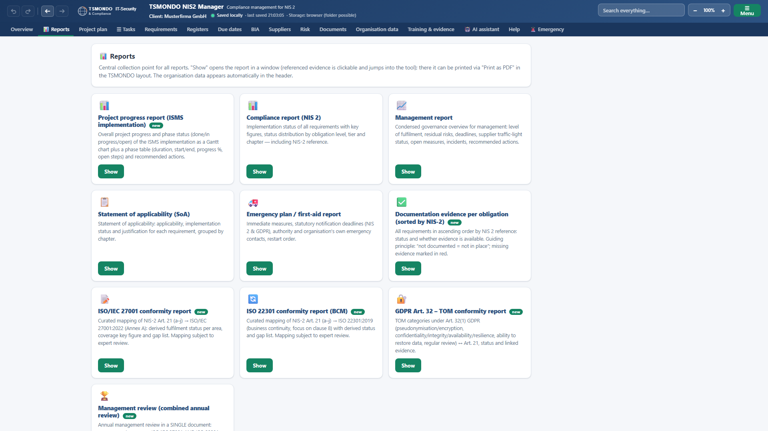
REPORTS
Evidence on
paper
10 reports, one click
Compliance report and statement
of applicability
Report for management
tsmondo.eu · Münster
18 / 20
Notes:
10 reports are ready to use. The compliance report shows the implementation status, the statement of applicability gives a justification for every single requirement, and the management report condenses the degree of fulfilment, residual risks, due dates and incidents into a few pages. Added to those are conformity reports for ISO 27001, for ISO 22301, and for Article 32 of the General Data Protection Regulation, as a curated mapping that is subject to expert review. Every report can be printed as a PDF.

Slide 20
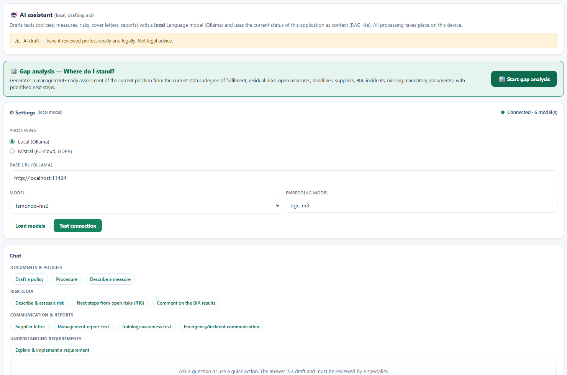
AI ASSISTANT
Drafting aid, not
a substitute
Local model or EU provider
A baseline assessment from your
own data
Every text stays a draft
tsmondo.eu · Münster
19 / 20
Notes:
The AI assistant is a drafting aid. It runs either with a local language model on your own machine or through a European provider, and the key stays stored locally. It knows the current state of the application and produces a baseline assessment from it, with prioritised next steps. In the emergency area it will draft a notification on request. Every text stays a draft and must be reviewed by a specialist.

Slide 21
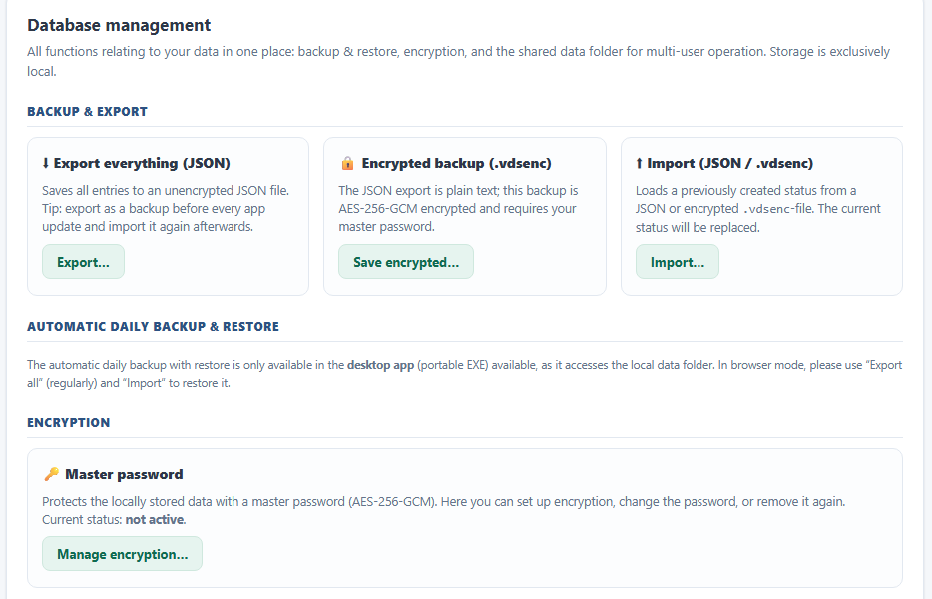
CLOSING
Your data,
your evidence
Your data stays local
Encrypted backup
Change log included
tsmondo.eu · Münster
20 / 20
Notes:
Your data stays on your own machine. Backups can be stored encrypted, a change log records who changed what and when, and in the desktop edition several people work from the same data through a shared data folder. Help, a quick start and the legal notes are built in as well.

Slide 22

Thank you.
tsmondo.eu · Münster
Compliance you can evidence, step by step.
Notes:
The NIS2 Manager turns a legal obligation into a documented and auditable position. Contact and further information at tsmondo.eu.

